Slide 1
HANDWRITTEN ANSWERSHEET EVALUATION APPLICATION
TEAM MEMBERS
Anandhan R(310917205003)
Srimathi B(310917205036)
Subakeshini R(310917205038)
GUIDE
Mr. I. George Fernandez
Assistant Professor,
Department of Information Technology.

Slide 2
OBJECTIVES
Answer sheet evaluation system that can automatically perform answer script correction in order to helping the human evaluators.
The main objective of this system is to provide application automatically and evaluate the answer based on the keyword provided to the application in form of the input by the moderator which will provide marks and will reduce time and manpower.
Providing the marks by the system which is similar to the marks provided by human evaluators.

Slide 3
INTRODUCTION
In this modern age, where the world moves towards automation, so there is a need for automation in answer evaluation system.
Answer sheet evaluation is an important issue now a days due to the large number of answer sheets and unrecognizable handwritings.
Identifying the answer key portions form students answer sheet is the most important procedure.
The Human evaluator sometimes not able to give marks correctly. So our system will evaluate, answer based on keyword provided by the user, and also manpower will be saved.

Slide 4
INTRODUCTION
It includes many processes like handwriting text recognition, answer key text recognition, apply NLP techniques and text comparison and provide results.
Tkinter is the standard GUI library for Python. Python when combined with Tkinter provides a fast and easy way to create GUI applications.
Google Cloud’s Vision API offers powerful pre-trained machine learning models through REST and RPC APIs. Used to detect objects and faces, read printed and handwritten text from our image catalog. .
(Natural Language Toolkit) NLTK is a popular open-source package in Python. Rather than building all tools from scratch, NLTK provides all common NLP Tasks.

Slide 5
LITERATURE SURVEY
S.NO | AUTHOR | TITLE OF PAPER | FINDINGS | NAME OF THE JOURNEL | YEAR
1. | D. Vaithiyanathan and M. Muniraj | Cloud based text extraction using Google cloud Vision | They analyze the image to extract the text using Google Cloud Vision API | 11th International Conference o Advanced Computing | 2019
2. | C. Kaundilya, D. Chawla, Y. Chopra | Automated Text Extraction from Images using OCR System | They use the tesseract tool to achieve text extraction from image. | 6th International Conference on Computing for Sustainable Global Development | 2019

Slide 6
LITERATURE SURVEY
S.NO | AUTHOR | TITLE OF PAPER | FINDINGS | NAMEOF THE JOURNEL | YEAR
3 | J.O. Contreras, S. Hilles, Z. B. Abubakar | Automated Essay Scoring with ontology based on Text mining and NLTK tools | They apply the NLTK to do the preliminary approach for essays to enhance the essay grading | International Conference on Smart Computing and Electronic Enterprise | 2018
4. | A.R. Lahitani, A.E. Permanasari and N.A. Setiawan | Cosine similarity to determine similarity measure | Using cosine similarity they evaluate the essays in text document. | 4th International Conference of Cyber & IT Service Management | 2016

Slide 7
EXISTING SYSTEM
Traditional answer evaluation i.e.. manual checking of answers, onscreen evaluation system is used to improve the evaluation process and more human resources are used.
Automated evaluation of answer is only digital text and online essay assessment, MCQs.
In text extraction phase, the Optical Character Recognizer (OCR) can reliably recognize printed text.
OCR tools using Offline Handwritten Text recognizer are used to extract the handwritten text.

Slide 8
PROBLEM STATEMENT
Simple evaluation takes a lot of time and does not guarantee a accurate dependable outcome.
In the same way its difficult for a common man to read the whole answer sheet and crosscheck the answers in the answer key and textbooks.
In Handwriting recognition OCR tools does not provide accurate recognition due to large amount of variations in handwriting.

Slide 9
PROPOSED SYSTEM
We build a application interface to perform automatically handwritten answersheet evaluation and display the result.
Extract the text from images using Tesseract OCR and Google Vision API.
In evaluation process changing the both answer key text and handwritten text into vector format and apply cosine similarity to measure the score of the answer.
To improve the evaluation process using NLTK(Natural language Toolkit) for processing the text.

Slide 10
REQUIREMENT ANALYSIS
HARDWARE REQUIREMENTS
Processor : corei3
Hard Disk : 500GB
RAM : 3GB and above
SOFTWARE REQUIREMENTS
Operating system : Windows, Linux, MacOS
Coding Language : Python3
Softwaretools : Tesseract OCR, PIP, tkinter interface

Slide 11
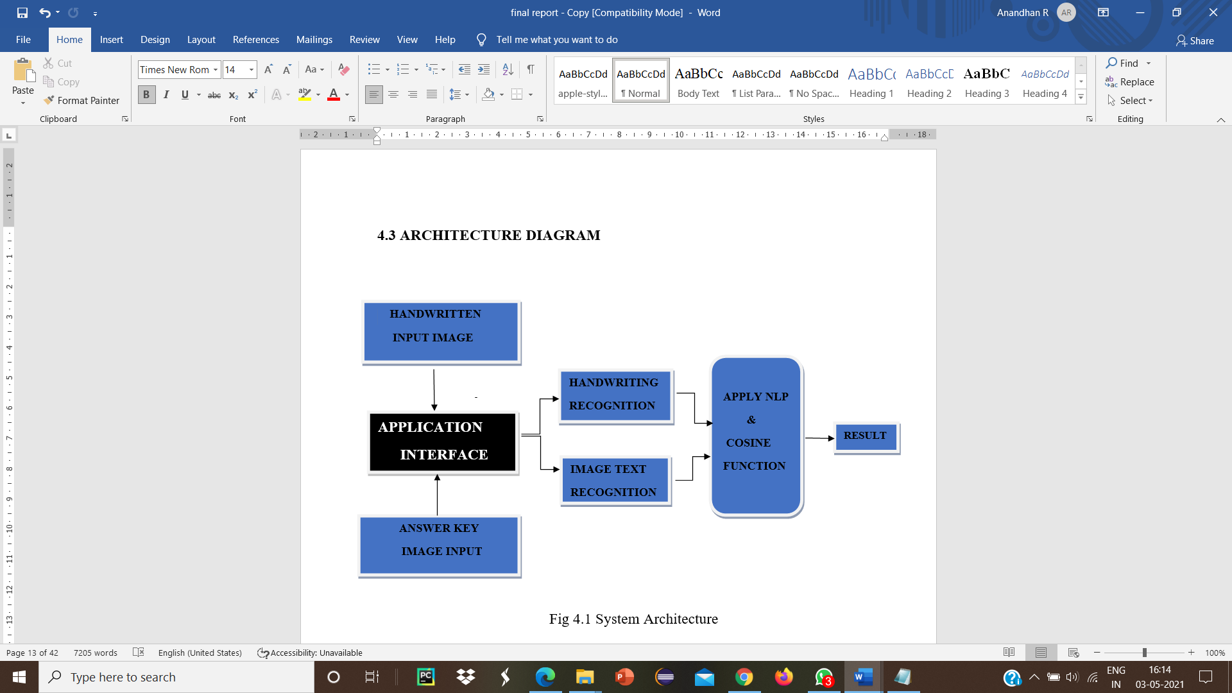
ARCHITECTURE DIAGRAM

Slide 12
METHODOLOGIES
The Answer key image and Student Handwritten image are given as a input to application interface
Extracting the text from both Answer key image and handwritten image
Processing the extracted text using NLP such as Tokenize , lemmentize and removing stop words by NLTK
Changing the text into vector format and apply Cosine similarity to get a result.

Slide 13
MODULES
OUR PROPOSED SYSTEM WORKS UNDER THREE MODULE:
Answer key text extraction module
Handwritten text extraction module
Evaluation module

Slide 14
ANSWER KEY EXTRACTION
OCR systems transform a two-dimensional image of text, that could contain machine printed from its image representation into machine-readable text.
Tesseract is an open-source OCR engine that can be used to extract the key word text. It performs the image Pre-processing, segmentation and feature extraction.
The machine readable text will be given as input to the evaluation model

Slide 15
HANDWRITTEN TEXT EXTRACTION
In this module we use the Google Cloud’s Vision API, it offers powerful pre-trained machine learning models through REST and RPC APIs.
Need to create a new project in google cloud platform console and select a service account to get private key in the form of JSON.
Using private key we implement this module in order to extract the handwritten text from student answer sheet.

Slide 16
EVALUATION MODULE
Through this model Processing the Text using Natural Language Processing Tool kit (NLTK) includes Grammer Check, remove stopwords Lemmatization.
Convert the text into vector format using TfidfVectoriser.
Cosine similarity measures the similarity between two vectors of an inner product space. It is measured by the cosine of the angle between two vectors and determines whether two vectors are pointing in roughly the same direction. It is often used to measure document similarity in text analysis.

Slide 17
FLOW DIAGRAM FOR EVULATION MODEL
EXTRACTED TEXT
TOKENIZATION
REMOVE STOPWORDS
LEMMATIZING
VECTORIZING
COSINE SIMALIRTY
RESULT

Slide 18
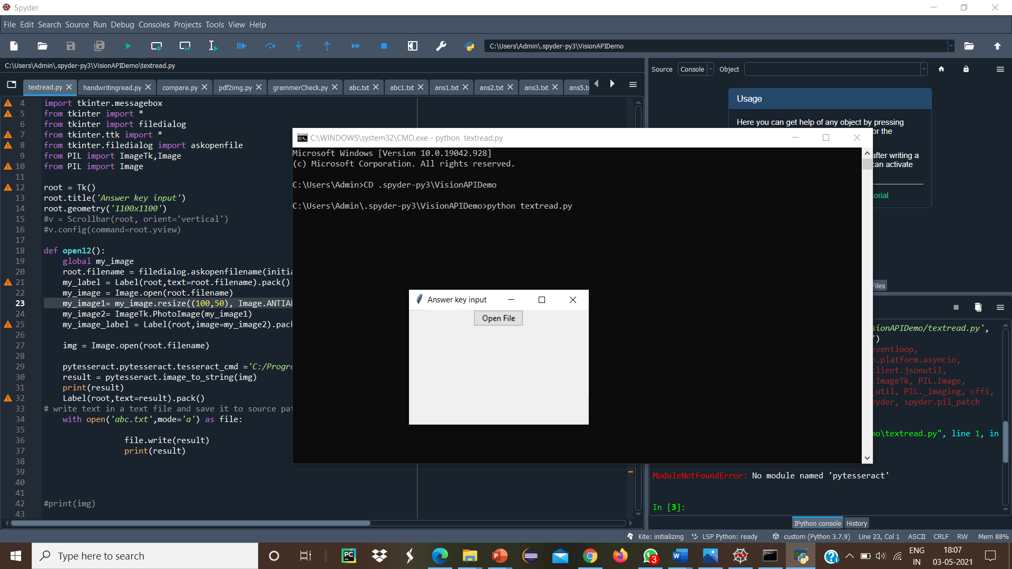
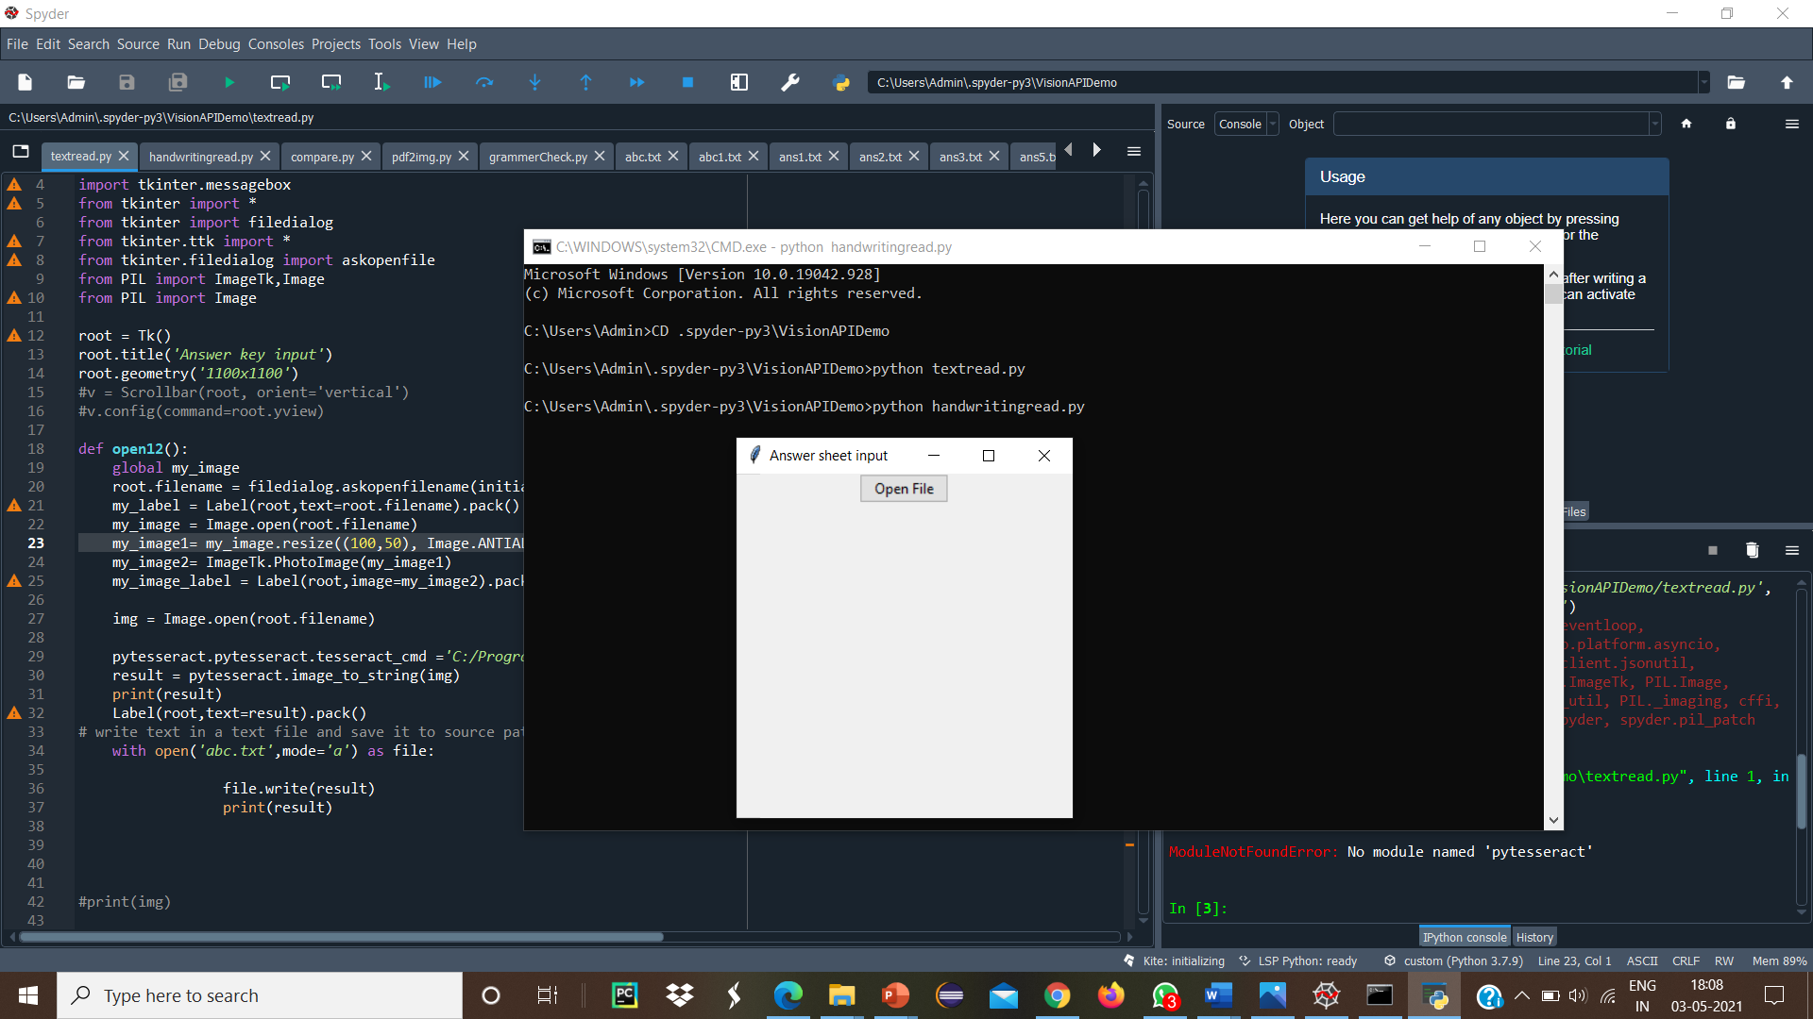
OUTPUT SCREEN

Slide 19
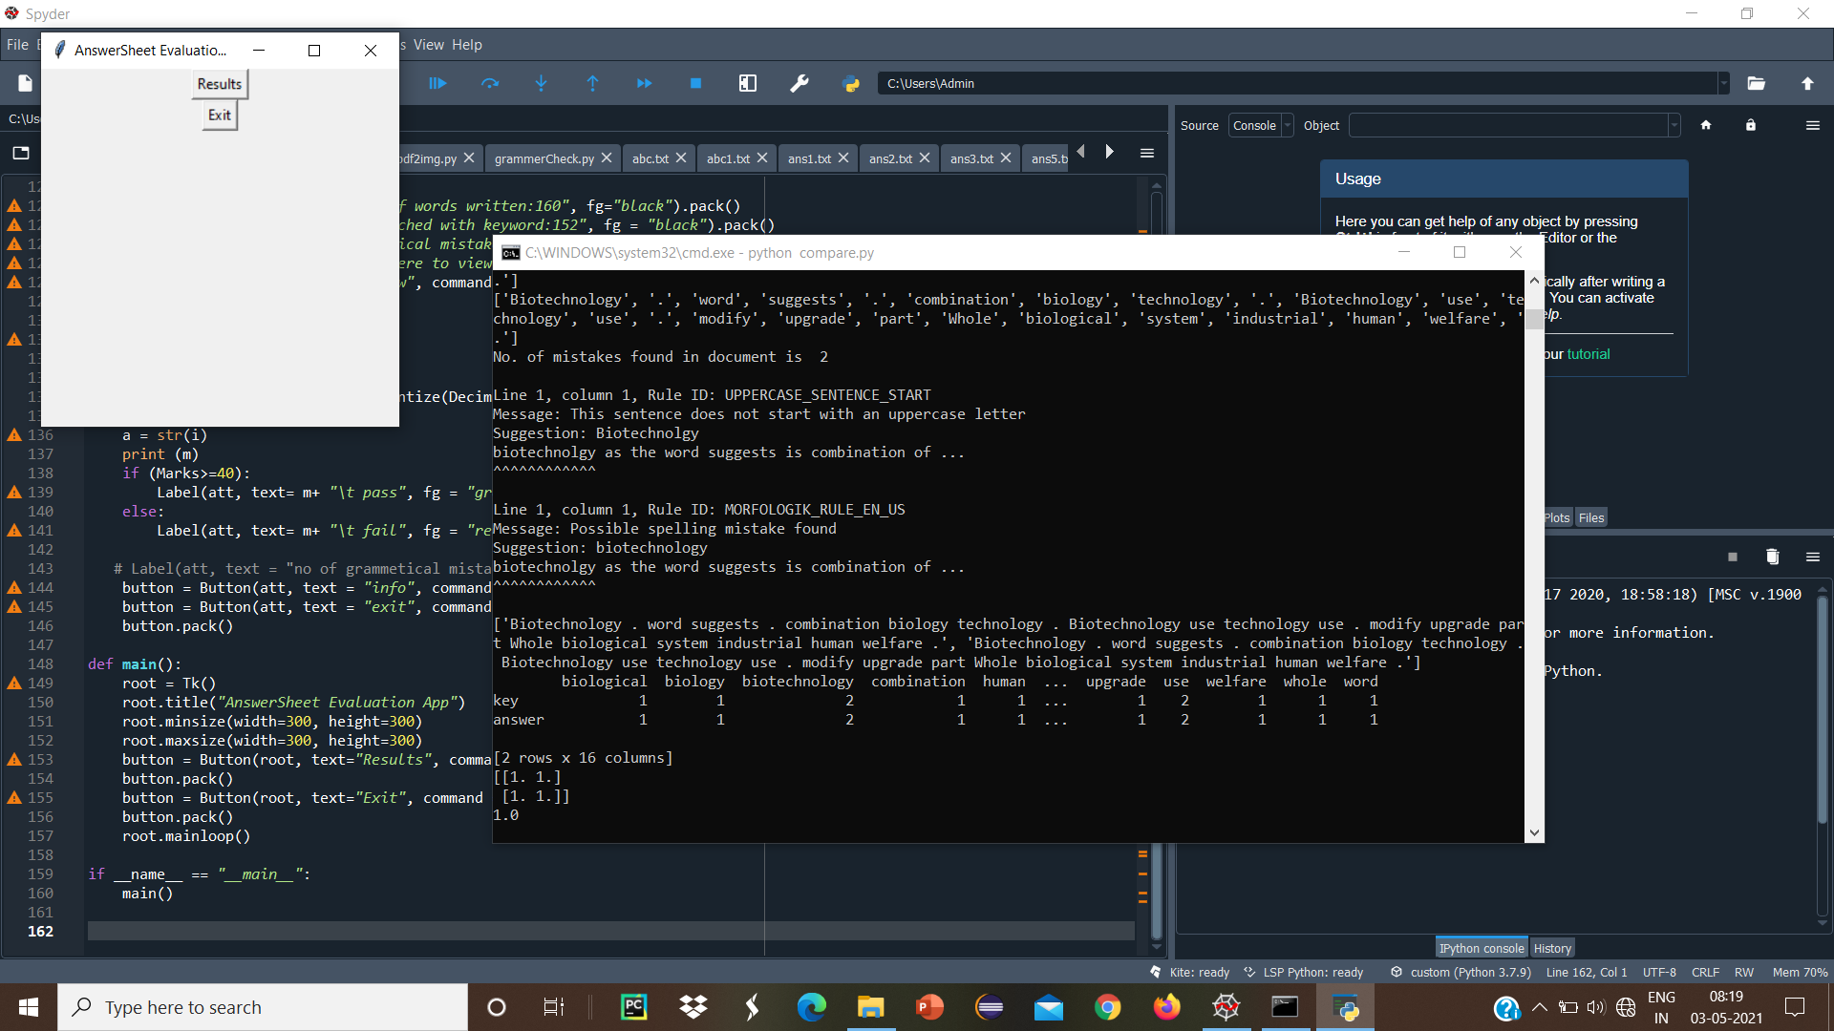
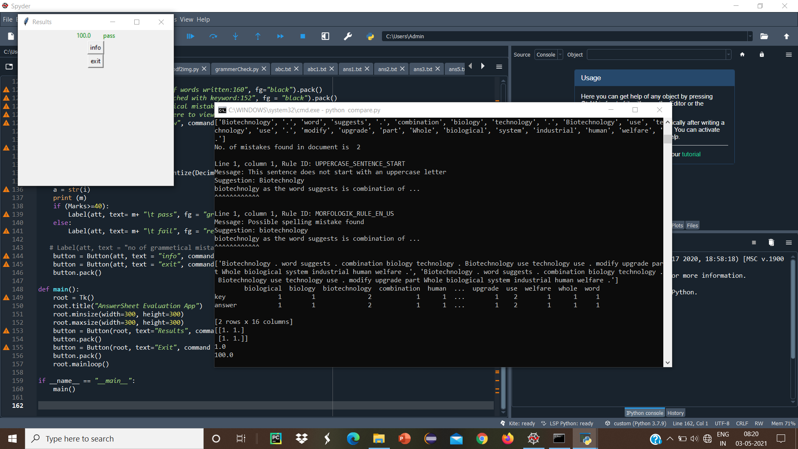

Finally the result of the student is shown in our application interface:

Slide 20
RESULTS
Our Proposed System is achieve better result with comparison to manual system. It tested in different students handwritten fonts and different kind of answers.
We get a result as nearly compared to human evaluators. And it eliminates the human effort and time to evaluate an answer

Slide 21
CONCLUSION
An approach for the design and implementation of automated handwritten
answer sheet evaluation system.
The application provides the better result of automated evaluation process as compared to human evaluator. Therefore by our application reduce the manpower and human error in evaluation process.
This application mainly helpful for the human evaluators to reduce their time and work.

Slide 22
FUTURE ENHANCEMENT
Further more in future, there is a possibility of producing better results in automated handwritten answer sheet evaluation system by focusing and adding semantic word analysis using gensim library in machine learning.

Slide 23
REFERENCES
[1] A. R.Lahitani, A. E. Permanasari and N. A. Setiawan, "Cosine similarity to determine similarity measure: Study case in online essay assessment," 2016 4th International Conference on Cyber and IT Service Management, Bandung, Indonesia, 2016, pp. 1-6, doi: 10.1109/CITSM.2016.7577578.
[2] Buddhiprabha Erabadda, Surangika Ranathunga and Gihan Dias, "Computer Aided Evaluation of Multi-Step Answers to Algebra Questions," IEEE Int. Conf. on Adv. Learning Technologies, pp. 45–65, vol. 28, 2016.
[3] C. Kaundilya, D. Chawla and Y. Chopra, "Automated Text Extraction from Images using OCR System," 2019 6th International Conference on Computing for Sustainable Global Development (INDIACom), New Delhi, India, 2019.
[4] Charusheela Nehete, Vasant Powar, Shivam Upadhyay and Jitesh Wadhwani, "Checkpoint –An Online Descriptive Answers Grading Tool," IJARCS, April 2017.

Slide 24
THANK YOU

